Slide 1
Brushing Up on Mouth Care
Program Evaluation in Long-Term Care Facilities in Nova Scotia
Presentation by Alexa Nicholson
Supervised by Shauna Hachey & Dr. Rebecca Affoo
Notes:
Hello everyone, my name is Alexa Nicholson and this is my project titled “Brushing Up on Mouthcare: a program evaluation in LTC facilities in NS”
This project has been supervised by Shauna Hachey and Dr. Rebecca Affoo

Slide 2
Outline
Background
Discussion
Conclusion & Future Directions
Methodology
Results
Limitations
Notes:
To outline my project, I will speak on the background, methodology, results, discussion & conclusion and future directions of the study
I’d like to start by providing some background information.

Slide 3
Brushing Up
Brushing Up:
An aid for upholding a high standard of oral care in LTC facilities
Suite of open access educational and training resources
Goal: improve oral health care routines in LTC
Long Term Care Program Requirements: Nursing Homes & Residential Care Facilities
Oral health outcome goal: optimize residents’ oral health through an effective mouth care regime
Notes:
A 2012 study of the oral status of older adults living in NS LTC highlighted disparities in access to care and high rates of unmet OH needs.
Also established in 2012, the Brushing up program was created at Dalhousie to support LTC facilities in upholding a high standard of oral care.
Brushing Up is a suite of open-access educational and training resources that is appropriate for both LTC staff and family and friend caregivers
In 2016, Nova Scotia included OH in their LTC Program Requirements, with the goal to optimise residents’ oral health through effective mouth care regime. Brushing Up also aids to meet this goal.
(Nova Scotia Health and Wellness, 2019).

Slide 4
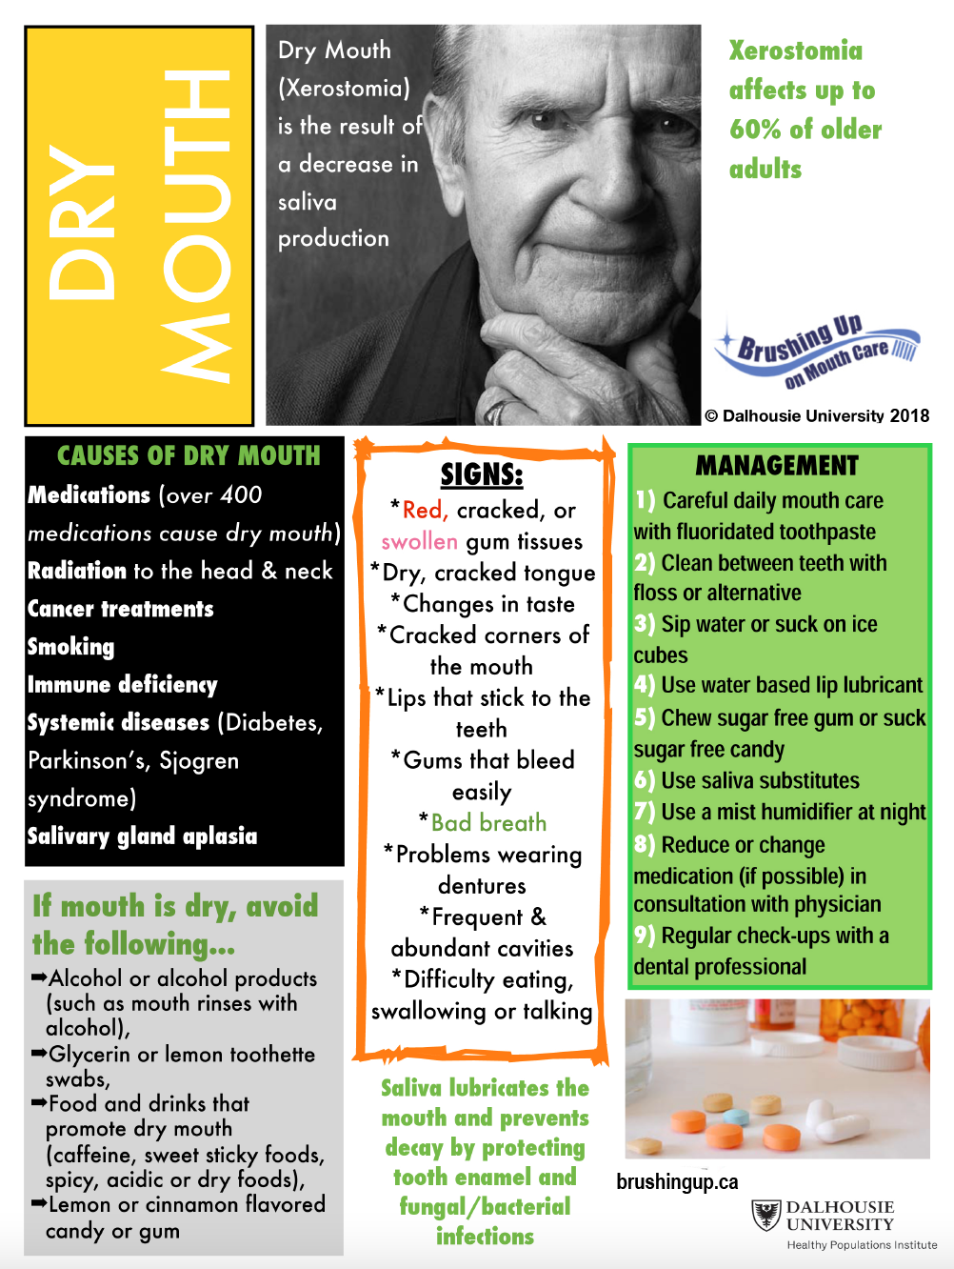
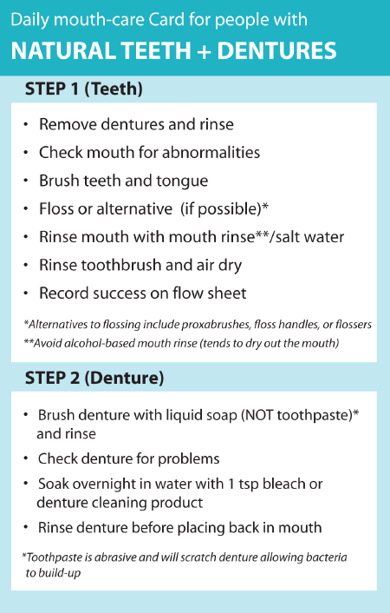
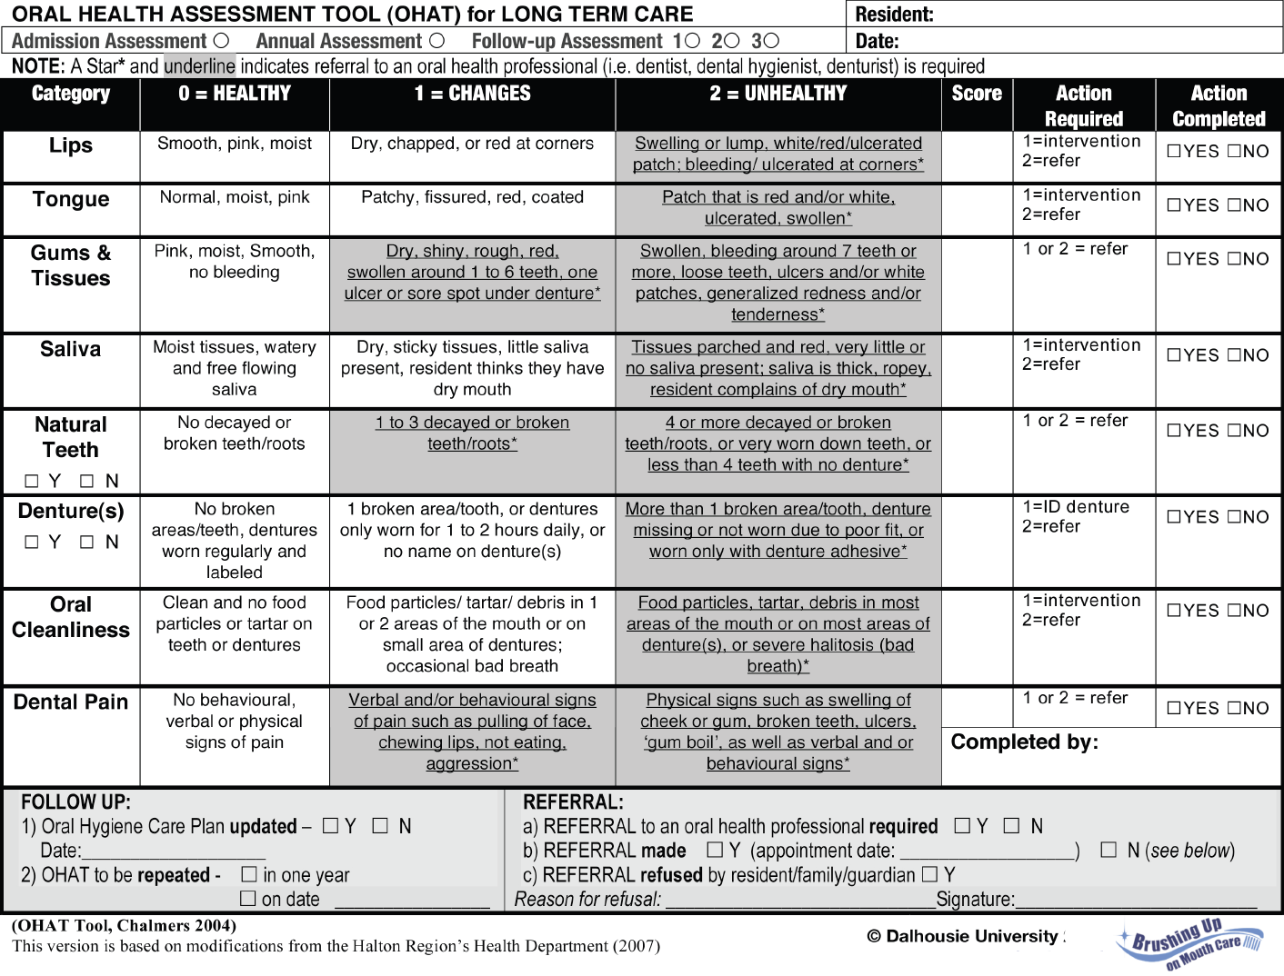
Brushing Up
Format
Oral Health Basics, Oral Health Products, Brushing Techniques, Special Considerations for Dementia and Palliative Care Patients
Oral Health Assessment Forms
Oral Care Planning Tools: flowcharts, plans and guidelines
Care Cards
Information Sheets on a variety of oral conditions
Binder and Website
Videos
Other resources
Notes:
Brushing Up has two different formats, a binder and a website
There are a series of videos
And a number of other resources which can be seen on the side here, including oral care cards, oral health assessment and planning tools and information sheets on a variety of oral conditions

Slide 5
Objectives & Hypothesis
Objectives:
Describe current oral care practices and determine if and how Brushing Up is being implemented in NS LTC facilities
Identify any potential barriers and facilitators for the implementation of Brushing Up and oral care
Seek potential recommendations for change
Hypothesis:
Brushing Up is not being used to its full potential
Oral care is lacking in LTC facilities
Notes:
The objectives of the current study are to:
Describe current oral care practices and determine if and how Brushing Up is being implemented in NS LTC facilities
Identify any potential barriers and facilitators for the implementation of Brushing Up and oral care
Seek potential recommendations for change
Our hypothesis is that Brushing Up is not being used to its full potential and that oral care is lacking in LTC
A decade after Brushing Up was developed, little is known about current oral care practices in NS LTC facilities.

Slide 6
Outline
Background
Discussion
Conclusion & Future Directions
Methodology
Results
Limitations
Notes:
Next I would like to discuss the methodology

Slide 7
methods
Semi-structured interview
Response data audio-recorded and transcribed in NVivo 12
Qualitative Descriptive Design
Notes:
Our methods included a qualitative descriptive design
Participants were asked to partake in a semi-structured interview and the response data was audio-recorded and transcribed in NVivo 12

Slide 8
Study population
Inclusion Criteria: | Exclusion Criteria:
Any of the 134 long-term care facilities in NS Participant Criteria: Decision makers Front line staff members who assist with ADLs Continuing Care Assistants Practical Nurses Registered Nurses | Retirement homes and independent living facilities Staff members who do not assist with ADLs
Notes:
Our target population was decision makers for oral care polices and front line staff members who assist with activities of daily living from any of the 134 LTC facilities in NS
Those excluded from the study included retirement homes and independent living facilities and staff members who do not assist with ADLs
The goal was to include 4 decision-makers and 4 frontline staff members, and to recruit further participants if new ideas emerged from the interviews.

Slide 9
recruitment
Select Target Facilities
Initial Contact
Potential Participants Identified
Contact & Invite Potential Participants
Conduct Interviews
Notes:
We started by selecting and contacting 5 facilities targeted based on factors including size, location and type of funding. They were introduced to the project and the participant criteria and asked to identify potential participants, who were then contacted and invited for interviews.

Slide 10
Data analysis
Transcriptions reviewed to identify key terms, phrases & passages
Codes created to label chosen sections of data
Coded data reviewed to identify themes
Themes reviewed to ensure accuracy and usefulness
Categories and subcategories created
Notes:
For data analysis, the transcriptions were coded to label key terms, phrases and passages. Codes were grouped into themes that were reviewed for usefulness and then categorized to present data in a meaningful way.

Slide 11
Outline
Background
Discussion
Conclusion & Future Directions
Methodology
Results
Limitations
Notes:
Next I would like to discuss the results of the interviews

Slide 12
demographics
Notes:
Health zones: 2 from Central zone, 3 from northern
Facility size: 4 >100 beds, 1 < 100 beds
Decision makers vs. frontline workers: 4 decision makers, 1 frontline worker

Slide 13
Results
Oral Care
Routines
Documentation
Brushing Up
Refreshers
Consultations
Facilitators
Adaptability
Knowledge
Recommendations
Staffing
Behavioral
Logistical
Training
Barriers
Oral Care Professionals
Notes:
The remainder of the results have been categorized and I will speak more to each of these in subsequent slides.

Slide 14
Oral care
Oral Care
Routines
Documentation
Training
“So we have baskets in their drawers with all their equipment together, and we've got cards over their beds for oral care”
“We use the OHAT assessment , so every residence is assessed within 24 hours of admission and then subsequently every six months after that"
“We spent a day where [new staff] follow my staff and would do all those things just like they do. So they're seeing it and then eventually, the next day, they'll do two or three residents and my staff are with them.”
Notes:
To highlight each of these categories and sub-categories, I chose a quote from the interviews that I feel best demonstrates the category
I wont read through the quotes but I will review the sub-categories
Speaking to oral care and objective #1 regarding oral care routines: every facility had an oral care routines and policies in place, which could be spoken to in detail.
Each facility also indicated that they had some form of documentation and training pertaining to oral care

Slide 15
Brushing up
Brushing Up
Adaptability
Knowledge
“The information itself is very good information and it's user friendly. I mean, sometimes we really want to put our own spin on things , but the core basis of it is what we use”
“The main thing was that we became more aware of what we should be looking at during our assessment…So I think that we're doing a better job and a more thorough job now”
Notes:
Also related to objective #1: we were looking to see if and how Brushing Up is being used.
Brushing Up is being used and in a variety of different ways. Some facilities use the care cards, others the OHAT tool, which speaks to the adaptability of Brushing Up
Other facilities noted that they used the information & knowledge supplied by Brushing Up to guide their own policies.
These findings also tell us about Brushing Up’s facilitators to use.
One of the key goals when developing BU was to make it comprehensive yet useable- so BU is being used as intended.

Slide 16
Facilitators
Facilitators
Oral Care Professionals
“We've had an onsite dental hygienist for probably three or four years now , which has been huge in just supporting the regulated health care providers, like our RNs and LPNs and their comfort in what they're seeing and how they're assessing and that sort of thing. So, we've done huge education with the hygienist for [the staff]. We do hugely value having access to her and her readily being on site, able to see the residents and then subsequently refer them on if it's necessary"
Notes:
Consultations with oral health professionals, both in house and outside professionals have been identified as a facilitator to improving implementations of oral care in general.
The importance of these consultations is highlighted by this quote: this facility has an on-site hygienist who has been integral in both providing care and supporting staff members in their comfortability in assessing oral health

Slide 17
barriers
Barriers
Staffing
Behavioral
Logistical
“Oral hygiene is a struggle, for sure. I think it's not from a lack of understanding of the importance. you know , everyone understands that of course, it’s more part of the daily challenges with staffing levels, with levels of care”
“[There is] more and more of a dementia diagnosis and treatment in long term care. So [residents are] not always the most compliant with personal hygiene and certainly oral care. “
“The problem with the [care] cards is that, like anything extra that goes in the wardrobe, they go missing”
Notes:
Related to objective #2: some barriers faced in the implementation of Brushing Up and oral care in general, included staffing, behavioral and logistical issues.
All facilities indicated that staffing levels and consistency were a common issue
Two facilities indicated that behavioral issues during personal care were common, especially in patients with dementia
There were logistical barriers to implementing brushing up, including that copies of care cards stood to get lost or facilities were not aware of them, and to implementing oral care in general: most notably, a lack of funding.

Slide 18
recommendations
Refreshers
Consultations
Recommendations
“If you had something pre-recorded, we could just have the icon on the computer, on the desk and a few of [the staff] could click on it when they wanted to sit and watch it, that'd be fantastic. They can refer to it anytime they want or, I could use it on the day where I want to have a chat.”
“I think having access to more resources like hygienist, like dentists that can come to the home or be available for a consult [would be helpful]”
Notes:
Finally, recommendations for the future, objective #3, included refreshers on oral care and best practices in the suggested formats of pre-recorded videos and in person skills nights.
Further, facilities indicating that having access to an oral care professional was beneficial also suggested that facilities without such access have some form of consultations with oral care professionals in the community.

Slide 19
Outline
Background
Discussion
Conclusion & Future Directions
Methodology
Results
Limitations
Notes:
Next I would like to go over the discussion

Slide 20
Oral care in ltc
Routines:
Every facility has an oral care routine
Could all be spoken to in detail
How effective?
Oral status in LTC?
Notes:
Routines:
Every facility has an oral care routine that they were able to describe in detail
This is great news
We hypothesized that oral care was lacking in LTC, yet oral care routines and policies exist
But, we also do not know the how well these oral care routines and policies are put into practice.
It is evident that further research is needed to explore both the implementation of existing routines and current oral health status to assess the effectiveness of these policies.
Literature suggests not well, yet we also do not have clinical data since the changes in NS were implemented

Slide 21
Oral Care providers
Barrier | Solution
Staffing Known issue in LTC Not limited to oral care | Access to oral care professionals
“Casual staff sometimes don't come with the same view on the residents on the floor as the staff that work with them every day”
Notes:
One of the main barriers faced in implementing Brushing Up and oral care in general was staffing.
It is well known that staffing is an issue in implementation of any personal care in LTC, including oral care
A solution, access to oral care professionals, has been identified, and is well endorsed and supported, yet this solution is not being implemented in LTC in NS.
LTC reform in Canada, is a very timely issue and has been noted in recent literature and news.
Proper staffing compensation to maintain consistent staff, and access to oral care professional for LTC facilities needs to be addressed in these reforms.
https://policyoptions.irpp.org/magazines/august-2021/long-term-care-reform-in-canada-will-require-a-massive-multi-year-effort/

Slide 22
Logistical considerations
Long-term care reform in Canada will require a massive, multi-year effort
Logistics:
Funding
“Germany, Japan and South Korea have been successful in providing universal LTC to their older populations, and they have maintained low death rates in care homes during the pandemic. All three countries have replaced their patchwork systems of LTC provided by local and regional governments with universal, public LTC insurance”
“…once they venture into long term care, their medical services are covered, but there's no coverage for oral hygiene"
“So some provincial funding is definitely necessary”
Notes:
Logistical considerations, particularly funding, was another barrier to oral care implementation
Two facilities indicated that lack of funding or dental coverage was an issue in implementing high standards of oral care.
Tertiary care is expensive, so government funding aimed at preventative dentistry instead, could help to relieve issues related to systemic conditions linked to poor oral health.
Some countries have had success with this type of funding in recent years.
https://policyoptions.irpp.org/magazines/august-2021/long-term-care-reform-in-canada-will-require-a-massive-multi-year-effort/

Slide 23
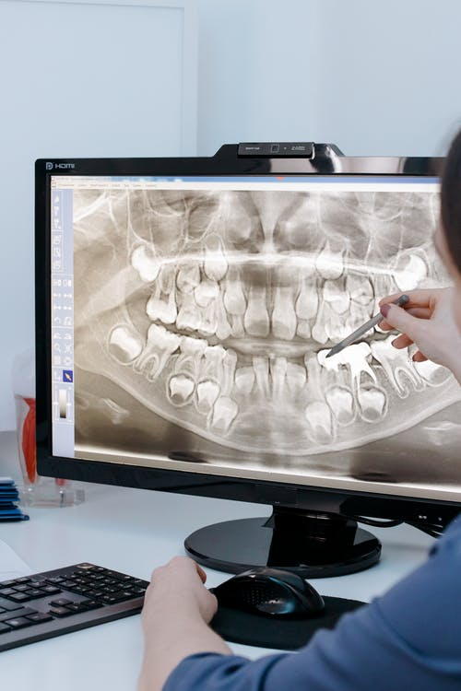
Promoting Brushing up
Refreshers
Identified as being beneficial
Speaks to importance of oral care to LTC staff
Pre-recorded video, in person skills night
Care Cards
Need to promote Brushing Up
Notes:
The majority of facilities indicated that refreshers on oral care would be beneficial, and a proposed delivery format was pre-recorded videos
- This speaks to the importance that LTC staff place on oral care
However, these types of videos already exist within the BU program
Further some facilities were not aware of the care cards
This leads us to wonder how we may be able to better promote the program in the future.

Slide 24
Outline
Background
Discussion
Conclusion & Future Directions
Methodology
Results
Limitations
Notes:
Next I would like to speak on our conclusions and future directions,

Slide 25
Conclusions & future directions
Oral care exists in LTC in NS
Further research is needed to explore the implementation of these routines and oral health status in LTC
Brushing Up is being used and adapted
Goal of Brushing is being met
Further promotion of the program is required
Barriers and Facilitators
Well known and documented
Solutions proposed
Notes:
Oral care routine exist in LTC
Further research is needed to explore their implementation and oral health status in long term care.
Brushing Up is being used and adapted, which means that the goal of BU is being met, contrary to our hypothesis
Further promotion of the program is required
There are barriers and facilitators to oral care implementation that are well known, documented in literature, and identified here. There are proposed solutions.
National reform is underway in Canada and it is clear that oral care must be included.

Slide 26
Outline
Background
Discussion
Conclusion & Future Directions
Methodology
Results
Limitations
Notes:
Lastly I will speak to some limitations

Slide 27
limitations
Limitations:
# of facilities interviewed
Decision makers vs. frontline workers
Notes:
This study was not without limitation.
Saturation was not reached , because new ideas were continuing to emerge during the interviews, to fully explore these ideas, more facilities and participants are needed.
Further, more decision makers than front line workers were interviewed
Interviewing more frontline workers may help to give a better idea about how these oral care routines are being implemented.

Slide 28
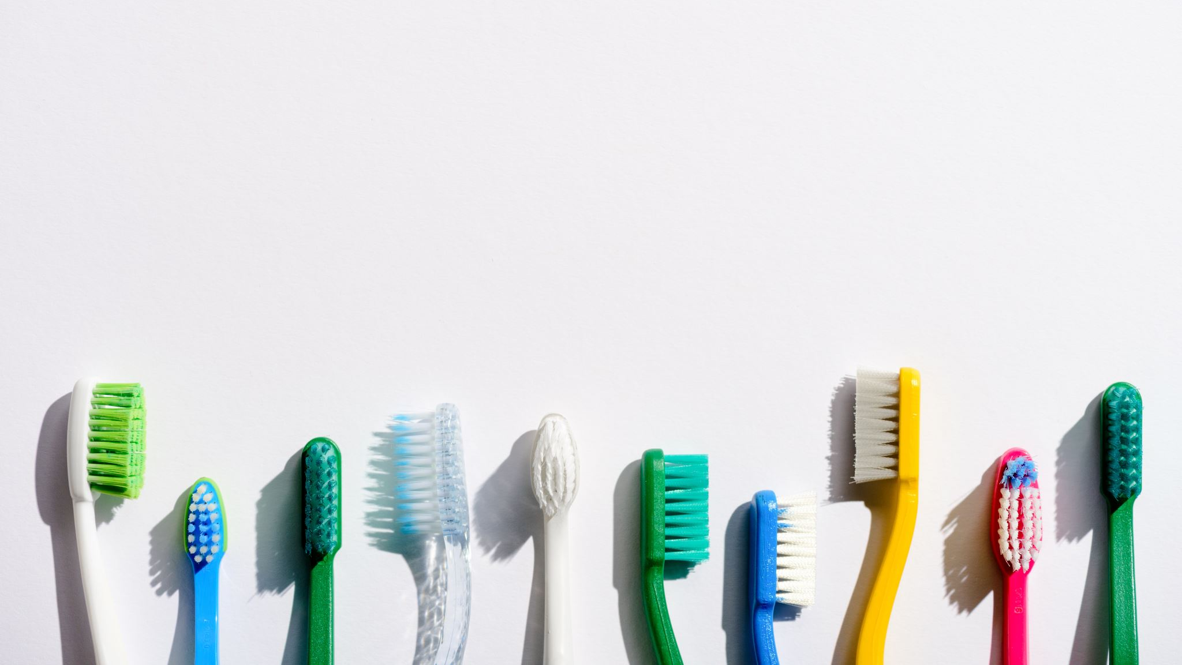
resources
N. G. Castle, & R. A. Anderson, “Caregiver Staffing in Nursing Homes and Their Influence on Quality of Care: Using Dynamic Panel Estimation Methods,” Medical Care, vol 49(6), pp 545–552, 2011
D.C. Matthews, J.B. Clovis, M.G. Brillant, M.J. Filiaggi, M.E. McNally, R.D. Kotzer and H.P. Lawrence, "Oral health status of long-term care residents-a vulnerable population," J.can.Dent.Assoc., vol. 78, pp. c3, 2012.
J.E. Bostick, M.L. Rantz, M.K. Flesner, C.J. Riggs, “Systematic Review of Studies of Staffing and Quality in Nursing Homes” J Am Med Dir Assoc, vol 7, pp 366-376, 2006.
“Long Term Care Program Requirements: Nursing Homes & Residential Care Facilities,” Nova Scotia Health and Wellness, March 19, 2019.
“National Standards for Long-Term Care: Addressing Oral Health for Overall Health : A discussion paper from theCanadian Dental Hygienists Association,” A Discussion paper from the Canadian Dental Hygienists Association, Nov 2021.
Brushingup.ca
https://policyoptions.irpp.org/magazines/august-2021/long-term-care-reform-in-canada-will-require-a-massive-multi-year-effort/
https://www.npr.org/sections/health-shots/2022/02/11/1077687493/for-travel-nurses-jobs-at-home-cant-come-close-to-pay-they-get-on-the-road

Slide 29
Questions?

